Slide 1
A Machine Learning based Approach to Reduce Behavioral Noise Problem in an Imbalanced Data: Application to a fraud detection
Salma El Hajjami*, Jamal Malki†, Alain Bouju†, Mohammed Berrada* *IASSE Laboratory, ENSA, USMBA Fez, Morocco

Slide 2
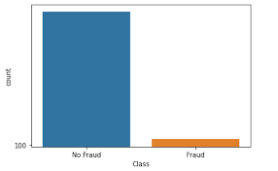
What is imbalanced data in machine learning?
Unequal class distribution
Disproportion among dataset
Majority class and Minority class
Problem faced due to imbalance

Slide 3
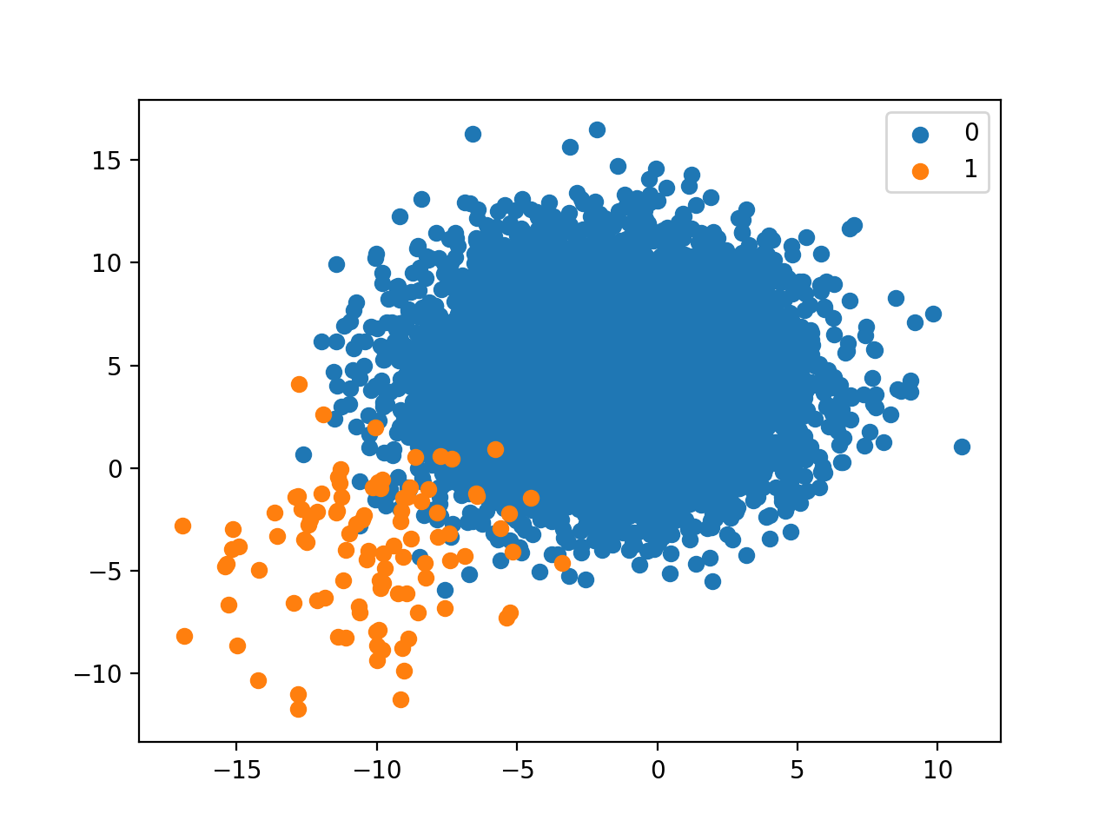
What is behavioral noise problem in it?
Problem normally focused on for imbalanced data
An alternative solution
How is it helpful

Slide 4

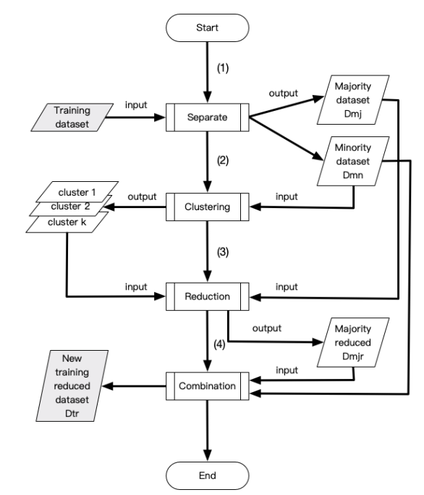
How is it overcome in this paper
Dividing the training dataset into majority and minority class
Creating clusters for minority class by features
Segregating and removing the data samples from majority class overlapping with clusters of minority class
Combining data sample to create new training dataset

Slide 5
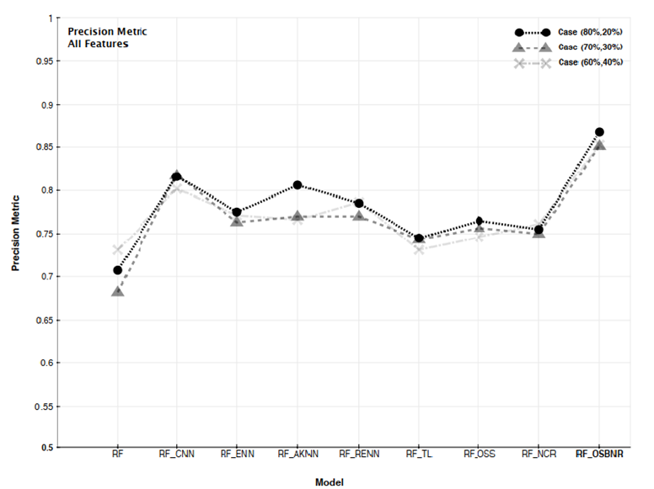
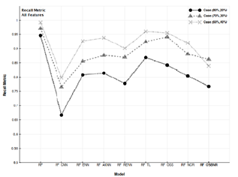
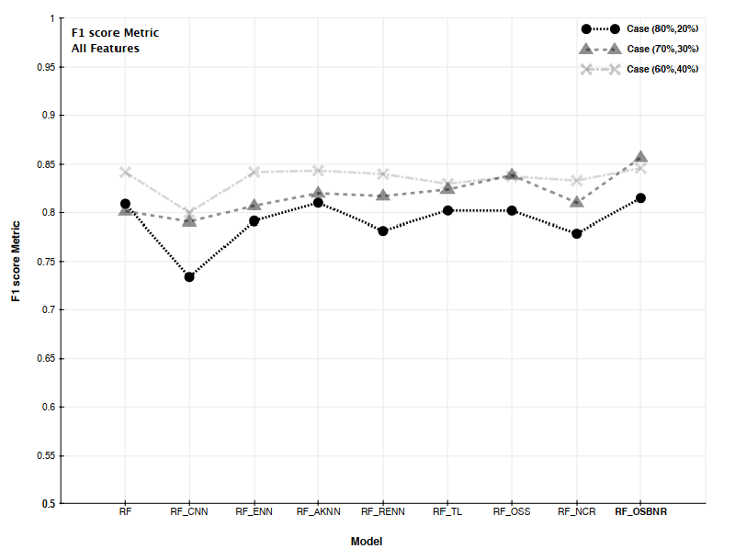
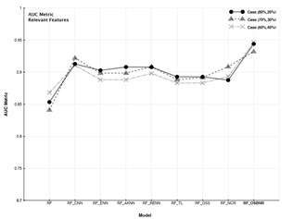
Effectiveness of reducing behavioral noise
Precision Metric Recall Metric .
F1 Score Metric AUC Metric .
Taking the dataset from this algorithm, the random forest classifier algorithm is trained and tested obtaining the following graphs.

Slide 6
Conclusion
In this paper, they have created a new approach to deal with the behavioral noise problem in imbalanced data which they have tested for some resampling approaches to test its effectiveness on dataset creating significant difference.

Slide 7
Implementation strategy
Converting testing dataset into majority and minority class using numpy and pandas
Creating clusters of minority class using k means nearest algorithm

Slide 8
Bibliography
Research paper link: http://ieeexplore.ieee.org.library.somaiya.edu/document/9264114
Machinelearningmastery.com
Analyticsvidhya.com

Slide 9

Thank You

